Slide 1

UNIVERSITY COLLEGE OF ENGINEERING, PANRUTI (A CONSTITUENT COLLEGE OF ANNA UNIVERSITY, CHENNAI) PANRUTI-607 106 DEPARTMENT OF COMPUTER SCIENCE AND ENGINEERING
FINAL YEAR PROJECT - REVIEW
RICE LEAF DISEASE DETECTION SYSTEM USING CNN
BATCH NO:10 DATE:09/05/2024
PRESENTED BY
DHARSHANA.S 422620104012
PRAVEEN.V 422620104030
VANITHA.V 422620104047
VIJAYANANTH.S 422620104049
GUIDED BY
Dr.A.RAMACHANDRAN ME.,MBA.,Ph.D.,
ASSISTANT PROFESSOR

Slide 2
ABSTRACT
2
The principal idea which empowered us to work on the project is to ensure improved and better farming techniques for farmers.
One of the key challenges in rice farming is the timely identification of leaf diseases, which can be caused by pathogens like fungi, bacteria, and viruses. Traditional methods of disease detection often rely on visual inspection by experts, which can be time-consuming and subjective.
In recent years, advancements in technology, especially in the field of computer vision and machine learning, have revolutionized the way we detect and diagnose plant diseases. By leveraging image processing techniques and deep learning algorithms, researchers and farmers can now automate the detection of rice leaf diseases with high accuracy and efficiency.

Slide 3
INTRODUCTION
3
The Rice Leaf Disease Detection System is an tool designed to assist farmers and agricultural experts in identifying various diseases that affect rice leaves.
With advancements in technology, particularly in the field of computer vision and machine learning, automated systems for rice leaf disease detection have become increasingly popular.
These systems typically involve the use of image processing techniques to analyze images of rice leaves and identify any signs of disease such as leaf discoloration, lesions, or other abnormalities.
Machine learning algorithms, particularly deep learning models like convolutional neural networks (CNNs), are often employed to classify these images into different disease categories.

Slide 4
LITERATURE SURVEY
4
S.NO | TITTLE | AUTHOR | YEAR | TECHNIQUES | PROS | CONS
1 | Deep learning-based crop pest and disease identification | Feng, C., Wang, Z., & Zhang, X. | 2022 | Focusing on deep learning techniques for crop pest and disease identification. | Emphasizes the role of deep learning in automated pest detection. | May not cover traditional image processing techniques comprehensively
2 | IOT-based intelligent system for early detection of plant diseases | Salam, M.A.,et al | 2021 | Internet of things and Machine learning | Proposes on Iot based system for early detection of plant diseases. | Challenges in implementing IOT System in remote agricultural area

Slide 5
LITERATURE SURVEY
S.NO | TITTLE | AUTHOR | YEAR | TECHNIQUES | PROS | CONS
3 | Image Processing Techniques for Automated Citrus Greening Disease Detection. | Islam, S. M. R., Mahmud, M., & Nayeem, M. | 2019 | Color segmentationfeature extraction, machine learning classification (CNN). | Utilizes deep learning (CNN) for automated disease detection | Requires large annotated datasets for training CNN models
4 | Transfer learning for plant diseases detecting using CNN | Toda,y., et al | 2018 | Transfer learning (pretrained CNNs) | Improve the performance in plant disease detection | Limited availability of pretrained CNNs

Slide 6
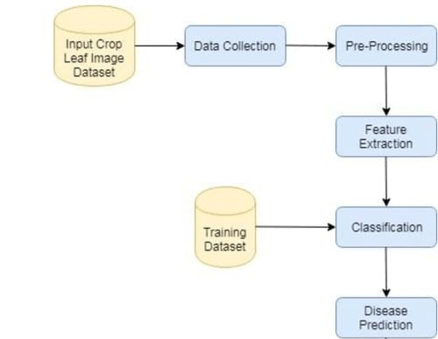
SYSTEM ARCHITECTURE

Slide 7
METHODOLOGY
5
Image Acquisition: Images of rice leaves are captured using cameras or other imaging devices.
Preprocessing: The images are preprocessed to enhance features and remove noise.
Feature Extraction: Features relevant to disease detection, such as texture, color, and shape characteristics, are extracted from the preprocessed images.
Classification: some of the popular pre-trained models used in transfer learning include VGG, ResNet, Inception, and Xception models are trained on these features to classify images into healthy or diseased categories and in some cases, identify specific diseases.

Slide 8
METHODOLOGY
6
Detection and Diagnosis: The classified images are then used for disease detection and diagnosis, providing insights to farmers for timely intervention and management
Post-processing: Refine the classification results to improve accuracy and remove any false positives or negatives. This step may involve filtering, morphological operations, or thresholding techniques.
Decision Making: Analyze the classified results to make informed decisions regarding pest management strategies. Provide actionable insights to farmers or agricultural professionals for timely intervention and control measures.

Slide 9
DATA COLLECTION
The dataset used in this project was collected from Kaggle, a platform for data science and machine learning.
The dataset contains 119 files belonging to three classes. And the three classes include,
1. Bacterial leaf blight
2. Leaf smut
3. Brown spot

Slide 10
ALGORITHM
Transfer learning is a technique in deep learning where a pre-trained neural network model is used as a starting point for a new task instead of training a new model from scratch.
This approach has gained popularity in recent years due to the high cost of training large neural networks on big datasets. Transfer learning can significantly reduce the time and computational resources needed to build accurate deep learning models, especially when the new task has a small amount of data.
In our rice leaf disease classification project, we can leverage transfer learning by using pre-trained models that have been trained on large image datasets, such as ImageNet, and fine-tune them on our rice leaf disease dataset.
This can help our model learn features and patterns that are common across different image recognition tasks, and improve its accuracy and generalization capabilities.

Slide 11
ALGORITHM
InceptionV3 is a convolutional neural network architecture designed for image classification tasks.
InceptionV3 is a deep convolutional neural network architecture that was developed by Google. It is known for its efficiency in training and accuracy in image classification tasks. The model uses a combination of convolutional layers with varying kernel sizes to capture features at different scales.
VGG16 is a deep convolutional neural network architecture proposed by the Visual Geometry Group at the University of Oxford.
The architecture consists of 16 layers, including 13 convolutional layers and 3 fully connected layers, and has been widely used as a base model for transfer learning in various computer vision tasks.
ResNet unique feature is the use of residual connections, which allow for the training of much deeper neural networks without suffering from the problem of vanishing gradients. This makes ResNet especially wellsuited for image recognition tasks.

Slide 12
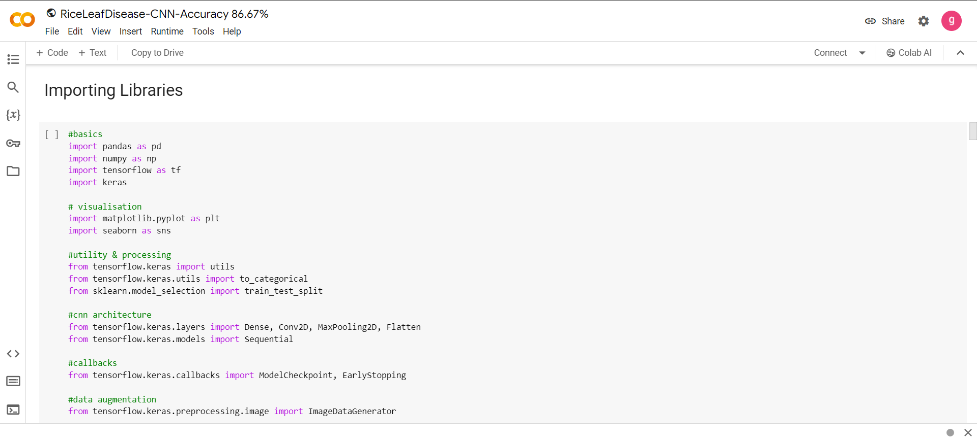
IMPLEMENTATION AND TESTING

Slide 13
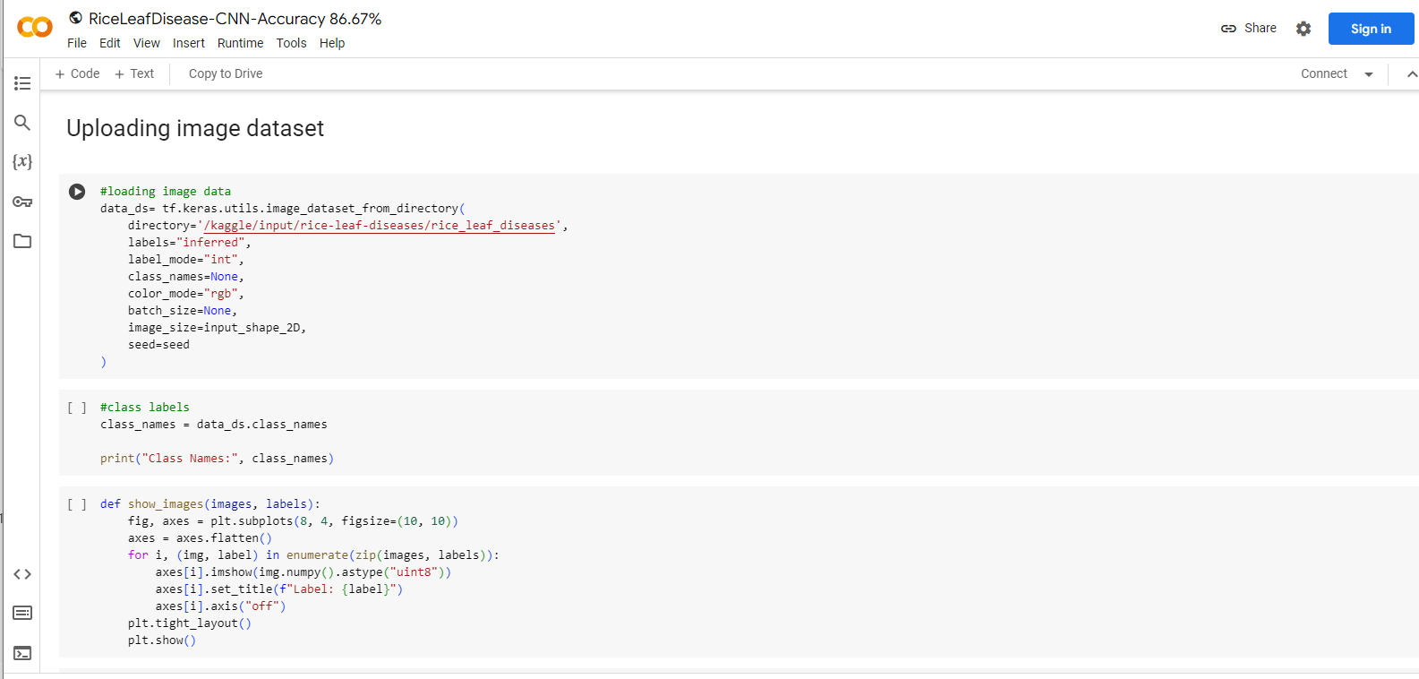
IMPLEMENTATION AND TESTING

Slide 14
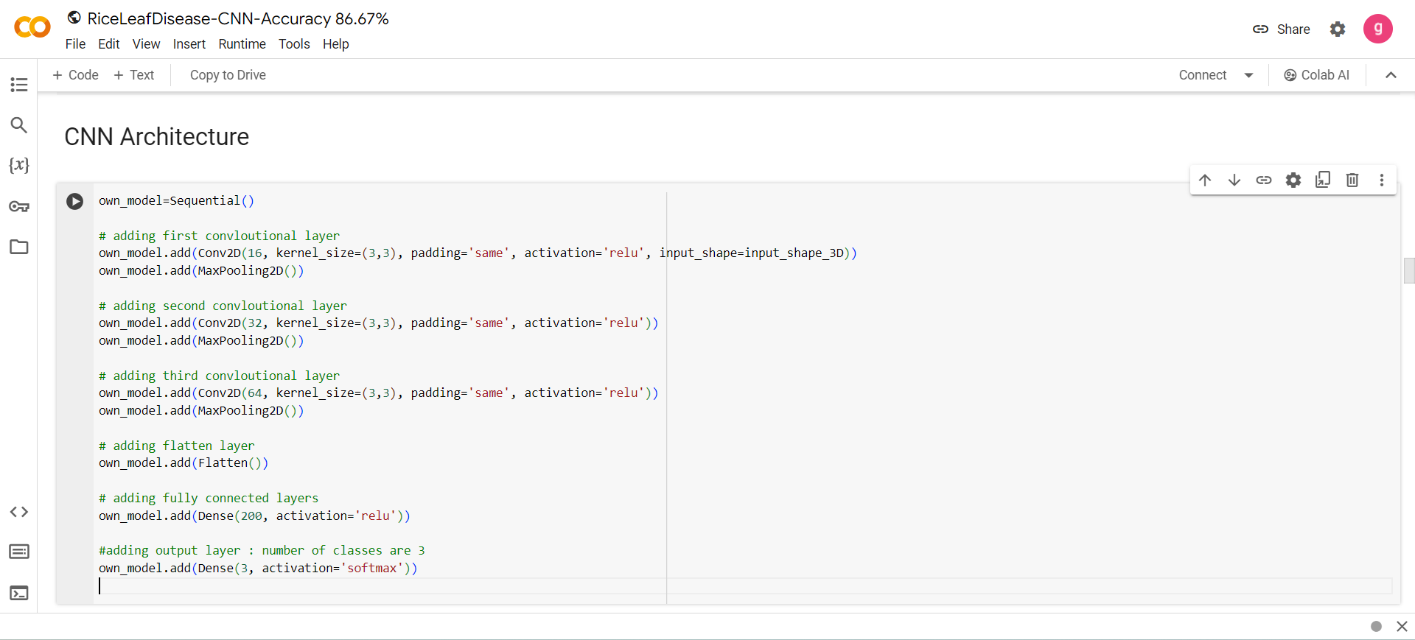
IMPLEMENTATION AND TESTING

Slide 15
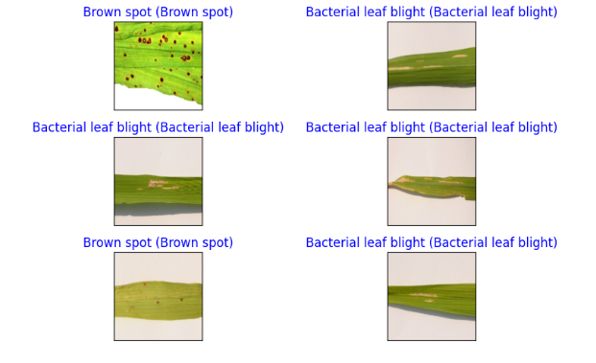
OUTPUT

Slide 16
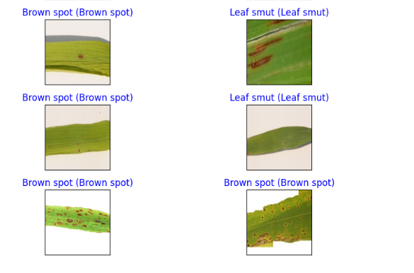
OUTPUT

Slide 17
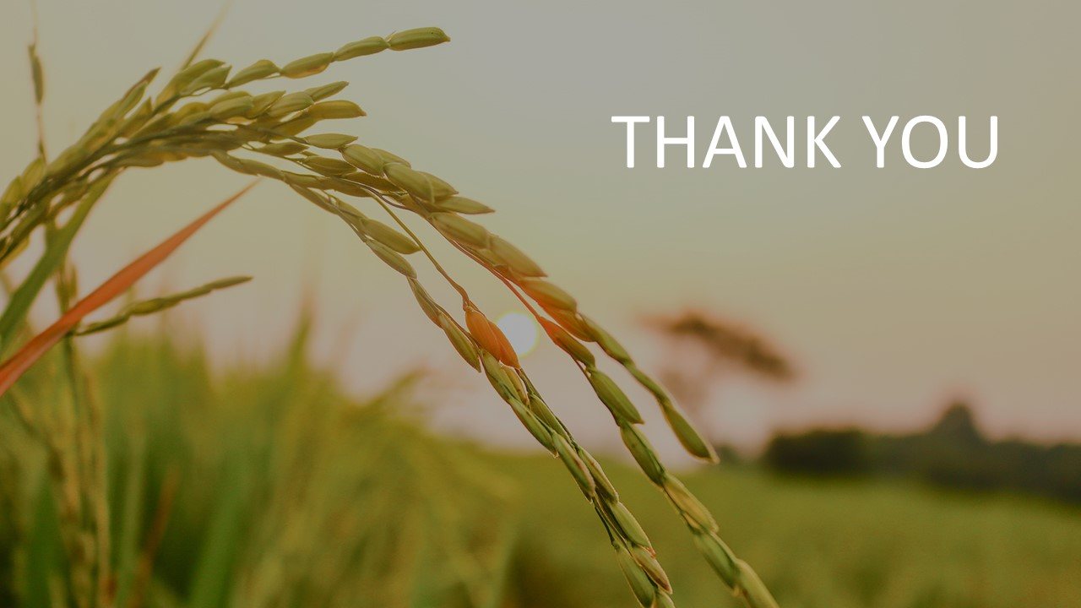
11

